Slide 1
MINI PROJECT
DONE BY:
KAVYA P B (2019PECCS143)
POOJA K (2019PECCS158)
GUIDED BY:
Dr K SANGEETHA

Slide 2

DETECTING FAKE NEWS
IN SOCIAL MEDIA

Slide 3
CONTENTS
Abstract
Introduction
Literature survey
Existing system
Required software
Required Hardware
Modules
Proposed system
System architecture
Use case diagram
Activity diagram
Class diagram
Algorithms
Advantages and Disadvantages
Conclusion

Slide 4
ABSTRACT
The advent of the World Wide Web and the rapid adoption of social media platforms (such as Facebook and Instagram) paved the way for disinformation dissemination that has never been witnessed in the human history.
With the current usage of social media platforms, consumers are creating and sharing more information than ever before, some of which are misleading with no relevance to reality.
In this work, we propose to use machine learning ensemble approach for automated classification of news articles.
Our study explores different textual properties that can be used to distinguish fake contents from real.

Slide 5
INTRODUCTION
Fake news is news designed to deliberately spread
disinformation.
It denotes a type of yellow journalism which intentionally
presents misinformation spreading through both traditional print news media and recent online social media.

Slide 6
INTRODUCTION
Nowadays, Online Social Media is dominating the world in several ways. Day by day the number of users using social media is increasing drastically. The main advantage of online social media is that we can connect to people easily and communicate with them in a better way. This provided a new way of a potential attack, such as fake identity, false information, etc.
In this paper, we use classification algorithms in machine learning to detect fake accounts. The process of finding a fake account mainly depends on factors such as engagement rate and artificial activity. We came up with an innovative method to identify fake accounts.

Slide 7
LITERATURE SURVEY
Year of publishing | Author Name | Title of the paper
19 March 2021 | Nihel Fathima Baarir ,Abdelhamid Dieffal | Fake News detection Using Machine Learning
Link: https://ieeexplore.ieee.org/document/9378748

Slide 8
LITERATURE SURVEY
Year of publishing | Author Name | Title of the paper
17 Oct 2020 | Iftikhar Ahmad, Muhammad Yousaf, Suhail Yousaf, and Muhammad Ovais Ahmad | Fake News Detection Using Machine Learning Ensemble Methods
Link: https://www.hindawi.com/journals/complexity/2020/8885861/

Slide 9
LITERATURE SURVEY
Year of publishing | Author Name | Title of the paper
28-30 Sept 2018 | İlhan AYDIN, Mehmet SEVİ, Mehmet Umut SALUR | Detection of Fake Twitter Accounts with Machine Learning Algorithms
Link : https://ieeexplore.ieee.org/document/8620830

Slide 10
LITERATURE SURVEY
Year of publishing | Author Name | Title of the paper
April 2018 | Shivam B. Parikh and Pradeep K. Atrey | Media Rich Fake News Detection
Link: https://www.researchgate.net/publication/325722738_Media-Rich_Fake_News_Detection_A_Survey

Slide 11
PROBLEM STATEMENT
To overcome the problem on social media that spreading false statements.
We aim to provide the user with the ability to classify the news as fake or real and also check the authenticity of the website publishing the news.

Slide 12
DEVELOPMENT ENVIRONMENT REQUIRED SOFTWARE
Operating system : Windows 10
Coding language : Python
Python libraries :Numpy,Pandas,Matplotlib

Slide 13
DEVELOPMENT ENVIRONMENT
REQUIRED HARDWARE :
Processor: 1 gigahertz (GHz) or faster processor or SoC.
RAM: 1 gigabyte (GB) for 32-bit or 2 GB for 64-bit.
Hard disk space: 16 GB for 32-bit OS or 20 GB for 64-bit OS.
Graphics card: DirectX 9 or later with WDDM 1.0 driver.

Slide 14
EXISTING SYSTEM
Data sets used to find out the better model
Importance of NLP
Time taken on using this detection is more
How to enforce your user privacy preferences
Average might have difficulties in properly setting potentially complex privacy preferences

Slide 15
DISADVANTAGES EXISTING SYSTEM
Personal data we are digitally producing are scattered.
Users are losing controls on their data ,whose protection is under the responsibility of data provider.
They cant fully exploit their data,since each provider keeps separate view on them

Slide 16
PROPOSED SYSTEM
In our proposed framework, as illustrated . we are expanding on the current literature by introducing ensemble techniques with various linguistic feature sets to classify news articles from multiple domains as true or fake. The ensemble techniques along with Linguistic Inquiry and Word Count (LIWC) feature set used in this research are the novelty of our proposed approach

Slide 17
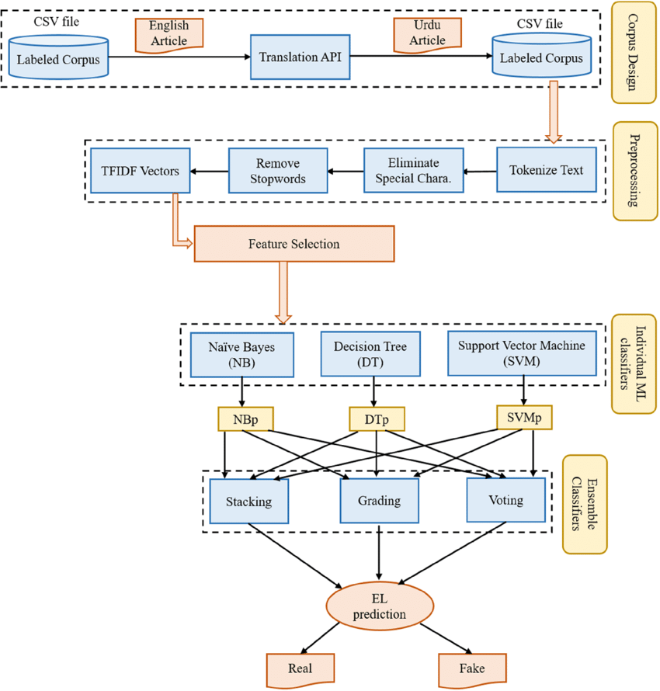
SYSTEM ARCHITECTURE

Slide 18
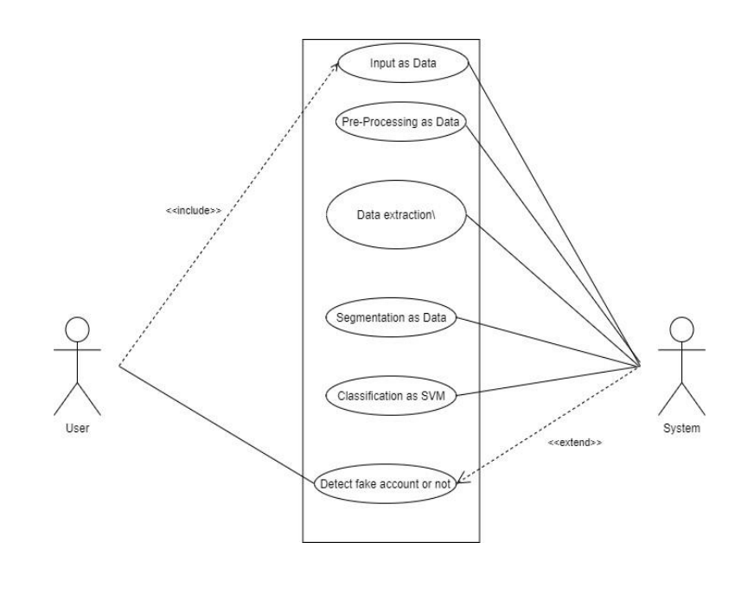
SYSTEM DESIGN USECASE DIAGRAM:

Slide 19
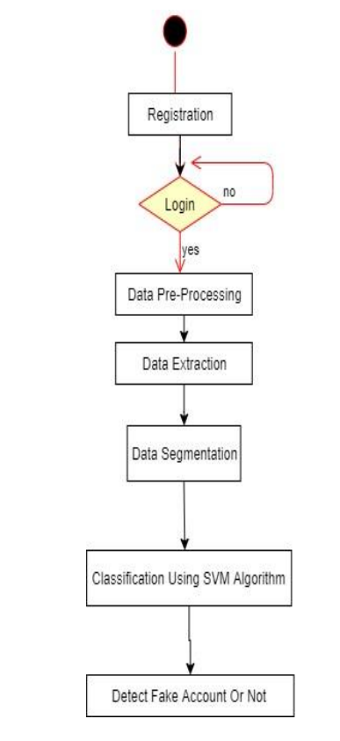
ACTIVITY DIAGRAM

Slide 20
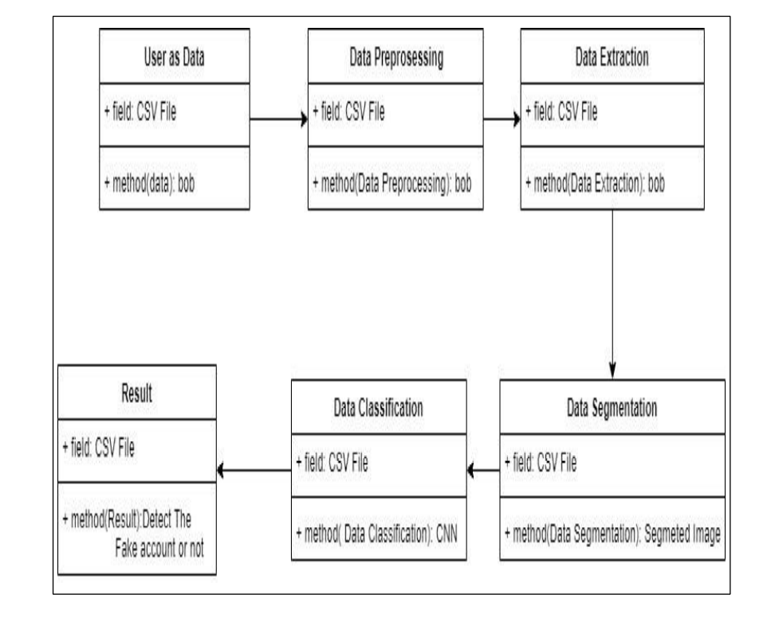
CLASS DIAGRAM

Slide 21
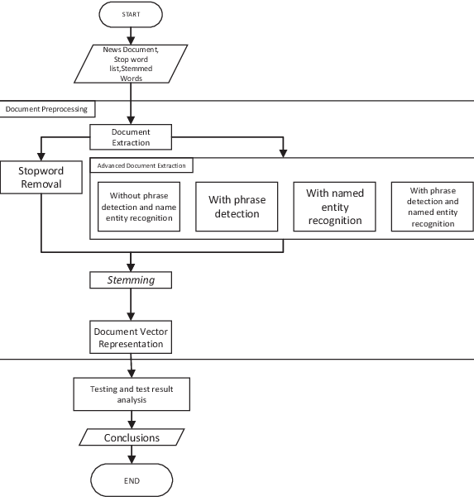
ER DIAGRAMS:

Slide 22
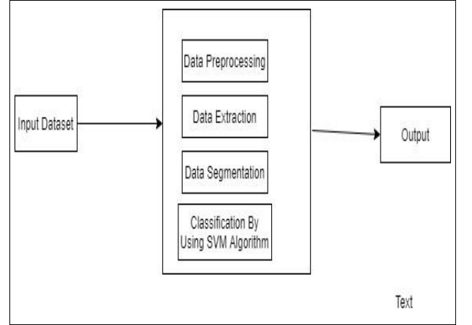
SYSTEM DESIGN DATA FLOW:

Slide 23
ALGORITHM
This section deals with training the classifier. Different classifiers were investigated to predict the class of the text.
We explored specifically four different machine- learning algorithms Multinomial NaAve Bayes Passive Aggressive Classifier and Logistic regression.

Slide 24
LOGISTIC REGRESSION
It is a classification not a regression algorithm. It is used to estimate discrete values (Binary values like 0/1, yes/no, true/false) based on given set of independent variable(s). In simple words, it predicts the probability of occurrence of an event by fitting data to a logit function. Hence, it is also known as logit regression. Since, it predicts the probability, its output values lies between 0 and 1 (as expected).

Slide 25
LOGISTIC REGRESSION
Mathematically, the log odds of the outcome are modelled as a linear combination of the predictor variables
Odds = p/(1-p) = probability of event occurrence / probability of not event occurrence
ln(odds) = ln(p/(1-p))
logit(p)=ln(p/(1-p))=
b0+b1X1+b2X2+b3X3….+bkXk

Slide 26
NaAve Bayes Classifier
This classification technique is based on Bayes theorem, which assumes that the presence of a particular feature in a class is independent of the presence of any other feature. It provides way for calculating the posterior probability.
( ) ( )
importance of a term in the document and entire corpus
( )
( )
TF stands for Term Frequency: It calculates how frequently a term appears in a document. Since, every document size varies, a term may appear more in a long sized document that a short one.

Slide 27
NaAve Bayes Classifier
Thus, the length of the document often divides Term frequency.
P(c|x)= posterior probability of class given predictor P(c)= prior probability of class
P(x|c)= likelihood (probability of predictor given class) P(x) = prior probability of predictor

Slide 28
FAKE NEWS DETECTION USING MACHINE LEARNING WITH PYTHON CODE
Importing Required Library
from google.colab import drive
drive.mount(&#39;/content/drive&#39;)
import pandas as pd
import numpy as np
import seaborn as sns
import matplotlib.pyplot as plt
from sklearn.model_selection import train_test_split
from sklearn.metrics import accuracy_score
from sklearn.metrics import classification_report
import re
import string
Inserting Fake And Real DataSet
df_fake = pd.read_csv(“/content/drive/MyDrive/Fake.csv”)
df_true = pd.read_csv(“/content/drive/MyDrive/True.csv”)
df_fake.head(5)
df_true.head(5)

Slide 29
FAKE NEWS DETECTION USING MACHINE LEARNING WITH PYTHON CODE
Inserting a column called "class" for fake and real news dataset to categories fake and true news.
df_fake["class"] = 0
df_true["class"] = 1
Removing last 10 rows from both the dataset, for manual testing
df_fake.shape, df_true.shape
df_fake_manual_testing = df_fake.tail(10)
for i in range(23480,23470,-1):
df_fake.drop([i], axis = 0, inplace = True)
df_true_manual_testing = df_true.tail(10)
for i in range(21416,21406,-1):
df_true.drop([i], axis = 0, inplace = True)
df_fake.shape, df_true.shape
Merging the manual testing dataframe in single dataset and save it in a csv file
df_fake_manual_testing["class"] = 0
df_true_manual_testing["class"] = 1
df_fake_manual_testing.head(10)
df_true_manual_testing.head(10)
df_manual_testing = pd.concat([df_fake_manual_testing,df_true_manual_testing], axis = 0)
df_manual_testing.to_csv("/content/drive/MyDrive/manual_testing.csv")

Slide 30
FAKE NEWS DETECTION USING MACHINE LEARNING WITH PYTHON CODE
Merging the main fake and true dataframe
df_marge = pd.concat([df_fake, df_true], axis =0 )
df_marge.head(10) df_marge.columns
#### "title", "subject" and "date" columns is not required for detecting the fake news, so I am going to drop the columns.
df = df_marge.drop(["title", "subject","date"], axis = 1)
df.isnull().sum()
#### Randomly shuffling the dataframe
df = df.sample(frac = 1)
df.head()
df.reset_index(inplace = True)
df.drop(["index"], axis = 1, inplace = True)
df.columns
df.head()
#### Creating a function to convert the text in lowercase, remove the extra space, special chr., ulr and links.
def wordopt(text):
text = text.lower()
text = re.sub('\[.*?\]', '', text)
text = re.sub("\\W"," ",text)
text = re.sub('https?://\S+|www\.\S+', '', text)
text = re.sub('+', '', text)

Slide 31
FAKE NEWS DETECTION USING MACHINE LEARNING WITH PYTHON CODE
#### Defining dependent and independent variable as x and y
x = df["text"]
y = df["class"]
#### Splitting the dataset into training set and testing set.
x_train, x_test, y_train, Y_test = train_test_split(x, y, test_size=0.25)
#### Convert text to vectors from sklearn.feature_extraction.text
import TfidfVectorizer
vectorization = TfidfVectorizer()
xv_train = vectorization.fit_transform(x_train)
xv_test = vectorization.transform(x_test)
### 1. Logistic Regression
from sklearn.linear_model
import LogisticRegression
LR = LogisticRegression()
LR.fit(xv_train,y_train)
pred_lr=LR.predict(xv_test)
LR.score(xv_test, y_test)
print(classification_report(y_test, pred_lr))

Slide 32
PREFORMANCE EVALUATION
Performance Metrics:
To evaluate the performance of algorithms, we used different metrics. Most of them are based on the confusion matrix. Confusion matrix is a tabular representation of a classification model performance on the test set, which consists of four parameters: true positive, false positive, true negative, and false negative (see Table 1).

Slide 33
PREFORMANCE EVALUATION
Table 1
Confusion matrix.
Predicted true Predicted false
Actual true True positive (TP) False negative (FN) Actual false False positive (FP) True negative (TN)

Slide 34
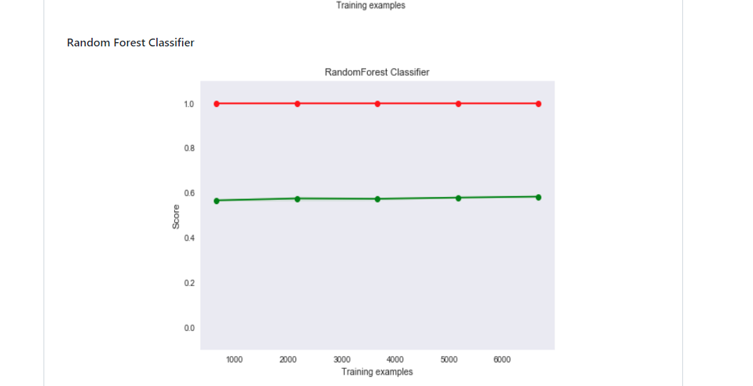
PREFORMANCE EVALUATION

Slide 35
PREFORMANCE EVALUATION
Recall:
Recall represents the total number of positive classifications out of true class. In our case, it represents the number of articles predicted as true out of the total number of true articles.
TP
Recall= TP+FN

Slide 36
PREFORMANCE EVALUATION
Precision
Conversely, precision score represents the ratio of true positives to all events predicted as true. In our case, precision shows the number of articles that are marked as true out of all the positively predicted (true) articles:
TP
Precision= TP+FP

Slide 37
PREFORMANCE EVALUATION
F1-Score
F1-score represents the trade-off between precision and recall. It calculates the harmonic mean between each of the two. Thus, it takes both the false positive and the false negative observations into account. F1-score can be calculated using the following formula:
Precision * Recall
F1-Score = 2
Precision + Recall

Slide 38
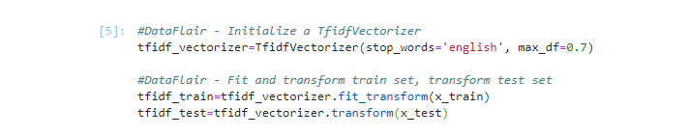
OUTPUT SCREENSHORTS

Slide 39
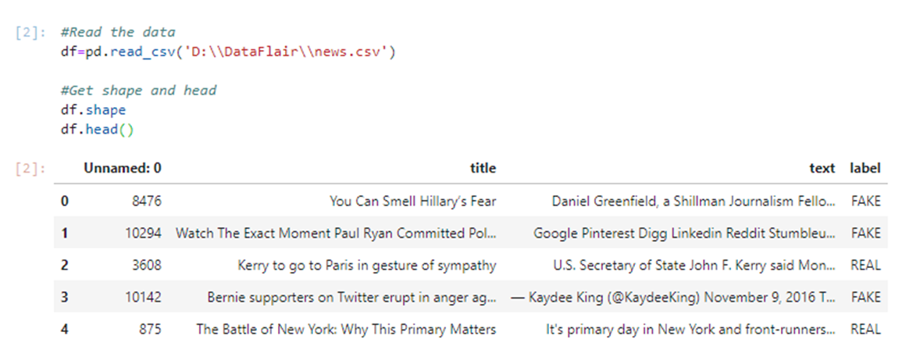
OUTPUT SCREENSHORTS

Slide 40
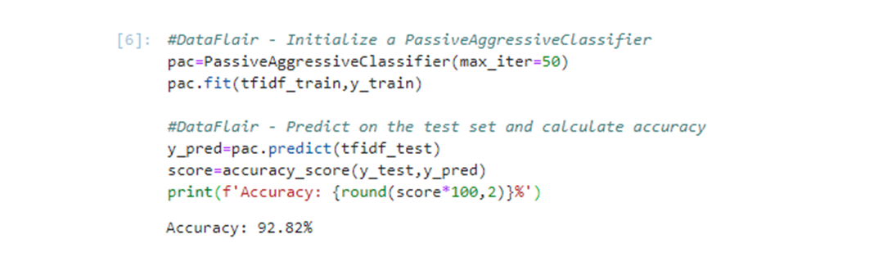
OUTUT SCREENSHORTS

Slide 41
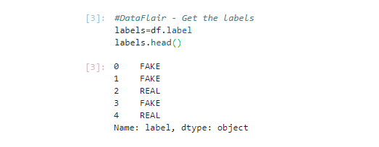
OUTPUT SCREENSHORTS

Slide 42
ADVANTAGES AND DISADVANTAGES
ADVANTAGES:
Fake News Detection system will help in controlling the spread of fake news over social media. This way, we can help the people to make more informed decisions, and they are not made to think about what others are trying to manipulate to believe.
A Fake News Detection system will reduce the burden to check the authenticity of the news manually and saves lots of time.
DISADVANTAGES:
The accuracy of detecting fake news will not be 100%. Therefore some articles may be predicted as false.

Slide 43
CONCLUSION
Manual classification of news articles requires indepth knowledge and expertise in identifying anomalies in the text. It takes a lot of time to verify a single article manually that’s why we have discussed the problem of classifying fake news articles using machine learning models and ensemble techniques.
It is important that we have a mechanism to detect fake news, or at least an awareness that not everything we read on social media may be true. That is why we always have to think critically.
This way, we can help the people to make more informed decisions, and they won't be led to think about what others are trying to manipulate them into believing.

Slide 44
THANK YOU

